Slide 1
Employee Data Analysis using Excel
STUDENT NAME: LOGESHWARI.S
REGISTER NO: 312216785 / 0C4066E71734358B7FA426400E35D448
DEPARTMENT: B.COM (ACCOUNTING & FINANCE)
COLLEGE: SHRI KRISHNASWAMY COLLEGE FOR WOMEN

Slide 2
PROJECT TITLE
Employee Performance Analysis using Excel

Slide 3


AGENDA
Problem Statement
Project Overview
End Users
Our Solution and Proposition
Dataset Description
Modelling Approach
Results and Discussion
Conclusion
3/21/2024 Annual Review

Slide 4

PROBLEM STATEMENT
In our organization, evaluating employee performance is essential for ensuring productivity, fostering professional development, and aligning individual contributions with organizational goals. However, the current performance analysis process lacks consistency and clarity, leading to potential biases, ineffective feedback, and misalignment between employee efforts and organizational objectives.

Slide 5

PROJECT OVERVIEW
1. Objective
Purpose: To assess and improve employee performance across the organization. This involves evaluating current performance metrics, identifying areas for improvement, and developing strategies to enhance overall productivity and job satisfaction.
Goals:
To provide actionable insights into employee performance.
To identify high performers and those needing additional support or training.
2. Scope
Inclusions:
Collection of performance data across various departments or teams.
Analysis of performance metrics such as productivity, quality of work, adherence to deadlines, and interpersonal skills.
Exclusions:
External factors not directly related to employee performance (e.g., market conditions, personal life issues).

Slide 6

WHO ARE THE END USERS?
Business Executives and Managers
Data Analysts and Data Scientists
IT Professionals and System Administrators
Developers and Engineers
Product Managers
Human Resources (HR) and Talent Management
Financial Analysts

Slide 7

OUR SOLUTION AND ITS VALUE PROPOSITION
Conditional Formatting – missing value
Filtering – Remove blank cells
Formula – Performance for (=IFS(Z8>=5,”VERY HIGH”,Z8>=4,”HIGH”,Z8>=3,”MED”,TRUE,”LOW”)
Pivot table – Summarizing data set
Graph – Data visualization

Slide 8
Dataset Description
Employee data set source – Edunet dashboard
TOTAL 27 FEATURES
4 FEATURES USED
Business unit
Performance Level
Gender
First name

Slide 9

THE "WOW" IN OUR SOLUTION
Conditional Formatting – in that I deleting the blank and empty cells
Formula for analysing the employee performance using the formula
=IFS(Z8>=5,”VERY HIGH”,Z8>=4,”HIGH”,Z8>=3,”MED”,TRUE,”LOW”)
3/21/2024 Annual Review
9

Slide 10
MODELLING
DATA COLLETION
I collected the data from EDUNET dashboard load the collected data to Excel.
FEATURE COLLECTION
Collected the Feature about the employee data such as Business unit, performance
level, Gender ,First name
DATA CLEANING
Missing Values : Data may have missing entries due to various reason like error in data
collection or merging dataset from different sources
Detection : Identify missing values using functions
Handling Missing values : There are Several Strategies
Removal : remove rows or columns with missing value if they are not critical.
SUMMARY
Here I give the summary about the employee performance level and I visualizing
The data using the pivot table and create the graph
VALIDATION
Validation is a process of data analysis using the excel include the pivot table.
10

Slide 11
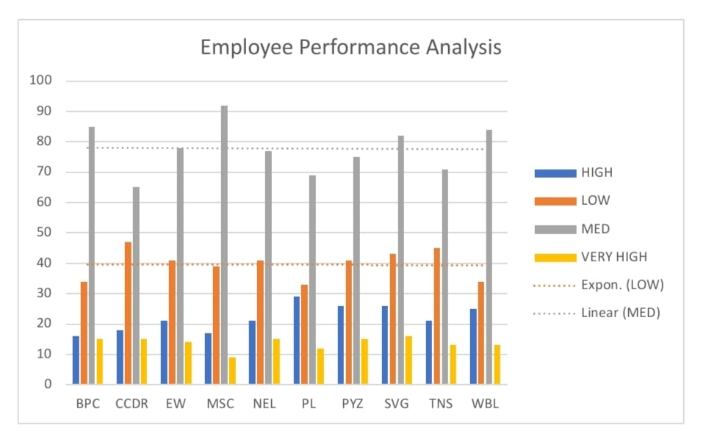
RESULTS
11

Slide 12
conclusion
Employee Performance is a corner stone of organizational success. By effectively managing and evaluating performance, organization can ensure that their work force is productive, engaged and aligned with the companies strategic goals. Regular performance assessment provide valuable insights into employee strengths and areas for improvement, enabling targeted development, better resource allocation and more informed decision making.

